Slide 1

Database Management System for Online Exam System
A Comprehensive Mini Project on Digital Examination Platform Development
BY:-
JAAYISH EV 240701197
ASWIN SIDDHARTH A 240701064
FAIYAS N 240701135

Slide 2

Abstract
Project Overview
Key Objectives
This mini project presents a comprehensive database management system designed specifically for conducting online examinations. The system addresses the growing need for automated, secure, and efficient assessment platforms in educational institutions.
Develop a secure, scalable database schema for exam management
Evaluation processes
Provide instant result generation and comprehensive analytics
The platform incorporates robust database architecture to manage student information, question banks, exam schedules, and real-time result processing.
Ensure data integrity and seamless user experience

Slide 3

Introduction
1
Traditional Era
Paper-based examinations with manual evaluation, prone to errors and requiring significant time and resources for conducting assessments.
2
Early Digital Phase
Introduction of computer labs for examinations with limited automation, basic database systems, and offline result processing.
3
Application Based Systems
Application based platforms enabling remote access, automated grading, and centralised data management with enhanced security features.
4
Modern Solutions
AI-powered proctoring, adaptive testing algorithms, comprehensive analytics, and seamless integration with learning management systems.
The evolution of examination systems reflects the broader digital transformation in education. Online exam systems have become essential infrastructure, particularly highlighted during recent global events that necessitated remote learning and assessment. This project develops a robust database-driven solution that addresses contemporary educational assessment challenges.

Slide 4





Existing System Analysis
Current Challenges in Traditional Examination Platforms
Time-Intensive Processes
High Operational Costs
Manual question paper preparation, physical distribution, and evaluation consume excessive time. Result declaration often takes weeks, delaying academic progression.
Printing, distribution, invigilation, and storage of physical papers require substantial financial investment and logistical coordination.
Security Vulnerabilities
Data Management Issues
Paper leakage risks, impersonation threats, and manipulation of answer sheets compromise examination integrity and fairness.
Fragmented record-keeping, difficult retrieval of historical data, and limited analytical capabilities hinder performance tracking and insights.
Legacy System Limitations
Limited scalability for large student populations
No real-time monitoring or progress tracking
Inconsistent evaluation standards across examiners
Geographical constraints requiring physical presence
Accessibility challenges for students with disabilities

Slide 5
Proposed System
A comprehensive online examination management solution built on a robust relational database architecture, designed to address all limitations of traditional systems whilst ensuring security, scalability, and user-friendliness.
Secure Authentication Module
Dynamic Question Bank
Automated Scheduling
Multi-level user authentication with role-based access control for administrators, instructors, and students. Password encryption and session management ensure data security.
Centralised repository supporting multiple question types: MCQ.
The results generates automatically the time the student completes the exam.
Real-Time Examination Conduct
Automated Evaluation Engine
Comprehensive Analytics Dashboard
Instant grading for objective questions with configurable marking schemes. Support for partial marking and negative marking as per examination policy.
Browser-based examination interface with timer, auto-submission, and anti-cheating measures including randomised question sequences and tab-switching detection.
Performance metrics, comparative analysis, trend identification, and detailed reports for educators and administrators to make data-driven decisions.

Slide 6
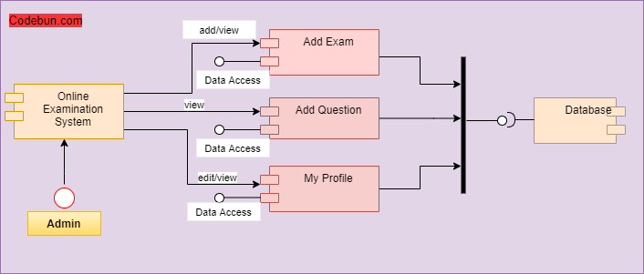
System Architecture Diagram
Multi-Tier Database-Driven Examination Framework
Core Database Tables
Key Relationships
Users: Student and instructor profiles
One-to-many: Exam to Questions
Exams: Examination metadata and configuration
Many-to-many: Students to Exams
Questions: Question bank with categorisation
One-to-one: Response to Result
Responses: Student answers and submissions
Foreign key constraints maintain referential integrity
Results: Evaluation outcomes and grades

Slide 7

Technology Stack and Methodology
Frontend Technologies
Backend Technologies
Security Measures
Java: Semantic markup and responsive styling
Java: Server-side logic and API development
Encryption: Password hashing with bcrypt/SHA-256
SQL: Relational database management
SQL Injection Prevention: Prepared statements
Development Methodology and Algorithms
Agile Development Approach
The project follows iterative development cycles with continuous integration and testing. Each sprint focuses on specific modules, enabling incremental feature deployment and stakeholder feedback incorporation.
Key Algorithms Implemented
Fisher-Yates Shuffle: Randomises question order to prevent cheating
Time Complexity Optimisation: Efficient query execution for large datasets
Auto-save Algorithm: Periodic backup of student responses every 30 seconds
Result Calculation: Weighted scoring with configurable marking schemes

Slide 8
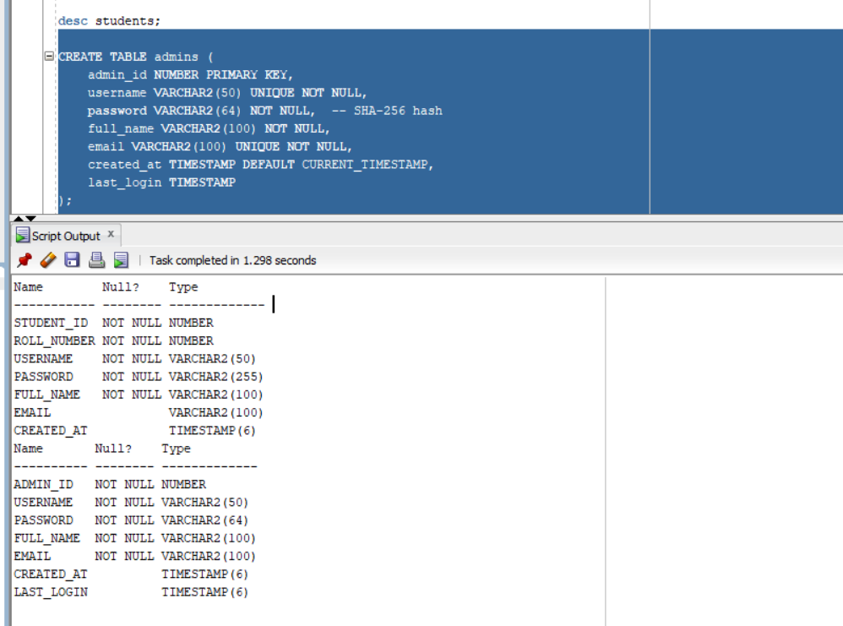
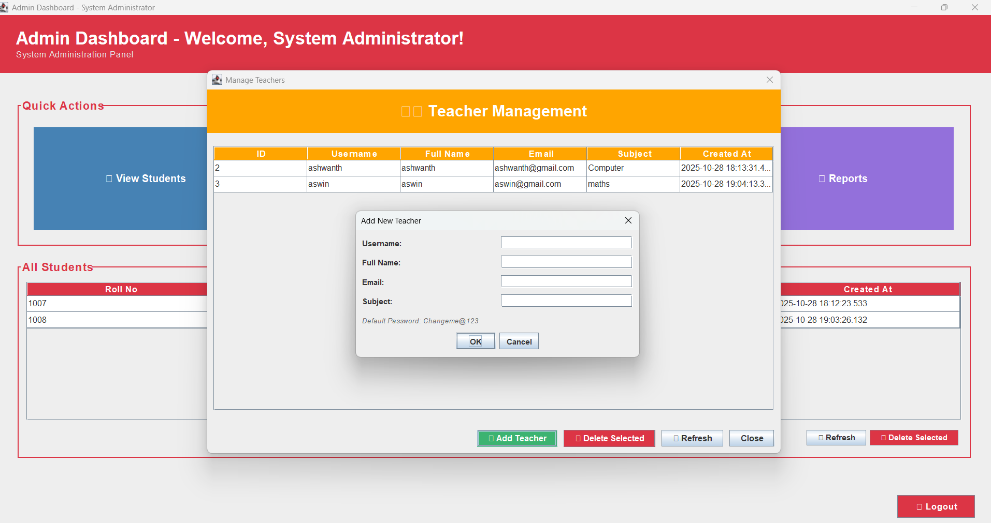
⁠Results With Output Screenshots

Slide 9

Conclusion
Project Outcomes
Future Scope
This database management system for online examinations successfully demonstrates the transformative potential of digital solutions in educational assessment. The project achieved all primary objectives whilst establishing a scalable foundation for future enhancements.
AI Integration
Machine learning for advanced proctoring, adaptive testing algorithms, and plagiarism detection in descriptive answers
Benefits Achieved
Efficiency: Dramatically reduced time and resource requirements
Mobile Applications
Security: Enhanced examination integrity through multiple safeguards
Native iOS and Android applications for enhanced mobile examination experience with offline capabilities
Accessibility: Enabled remote examination access for diverse learners
Analytics: Provided actionable insights through comprehensive data analysis
Scalability: Built architecture supporting institutional growth
Advanced Analytics
Predictive analytics for student performance, learning pattern identification, and personalised recommendation systems
Integration Capabilities
Seamless integration with LMS platforms, video conferencing tools, and third-party authentication services
"The successful implementation of this online examination system demonstrates that thoughtful database design, combined with modern web technologies, can revolutionise educational assessment whilst maintaining academic integrity and enhancing user experience."

Slide 10

References
1
Database Design
Elmasri, R. & Navathe, S. B. (2020). Fundamentals of Database Systems (7th Edition). Pearson Education. Comprehensive coverage of relational database design principles and normalisation.
2
Web Technologies
Duckett, J. (2021). JavaScript and jQuery: Interactive Front-End Web Development. Wiley. Practical guide to creating dynamic examination interfaces.
3
Security Standards
OWASP Foundation. (2023). OWASP Top Ten Web Application Security Risks. Available at: https://owasp.org/. Industry-standard security best practices.
4
Academic Research
Kumar, S. & Singh, R. (2022). "Design and Implementation of Online Examination System Using PHP and MySQL". International Journal of Computer Applications, 184(22), 12-18.
5
Agile Methodology
Schwaber, K. & Sutherland, J. (2020). The Scrum Guide. Scrum.org. Framework for iterative software development methodology applied in this project.
6
Industry Standards
ISO/IEC 27001:2022. Information Security Management Systems. International standards for securing examination data and user information.
Additional Resources
Project documentation, source code, and implementation guides are available in the project repository. Database schema diagrams and API documentation provide comprehensive technical specifications for future developers.

